Slide 1


Hamid Kaveh
December, 12, 2021

Slide 2

Outline
Executive Summary
Introduction
Methodology
Results
Conclusion
Appendix

Slide 3
Executive Summary
Summary of methodologies
Data collection
Data wrangling
EDA with SQL
EDA with data visualization
Folium
Machine Learning Analysis
Summary of all results
Data Analysis Results
Charts and Graphs
Prediction Results

Slide 4
Introduction
Project background and context
During this project we will predict if the Falcon 9 first stage will land successfully. SpaceX advertises Falcon 9 rocket launches on its website, with a cost of 62 million dollars; other providers cost upward of 165 million dollars each, much of the savings is because SpaceX can reuse the first stage. Therefore if we can determine if the first stage will land, we can determine the cost of a launch. This information can be used if an alternate company wants to bid against SpaceX for a rocket launch.
Problems you want to find answers
What influences if the rocket will land successfully?
What conditions does SpaceX have to achieve to get the best results
and ensure the best rocket success landing rate.

Slide 5


Slide 6
Methodology
Executive Summary
Data collection methodology:
SpaceX Rest API
Web Scrapping from Wikipedia
Perform data wrangling
One Hot Encoding data fields for Machine Learning and dropping irrelevant columns
Perform exploratory data analysis (EDA) using visualization and SQL
Perform interactive visual analytics using Folium and Plotly Dash
Perform predictive analysis using classification models
How to build, tune, evaluate classification models

Slide 7
Data Collection
Describe how data sets were collected.
We worked with SpaceX launch data that is gathered from the SpaceX REST API.
payload delivered, launch specifications, landing specifications, and landing outcome.
The SpaceX REST API endpoints, or URL, starts with api.spacexdata.com/v4/.
Another popular data source for obtaining Falcon 9 Launch data is web scraping Wikipedia using BeautifulSoup.
SpaceX Reset API
Getting .json file
Normalize Data and Converting to .csv file.
Getting HTML file from Wikipedia
Using BeautifulSoup for preparing data
Normalize Data and Converting to .csv file.

Slide 8
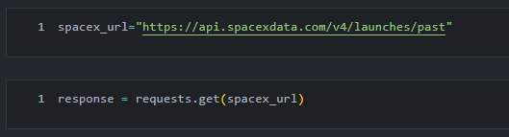
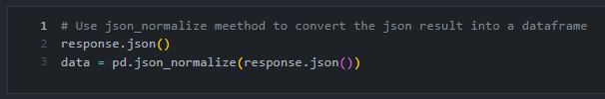
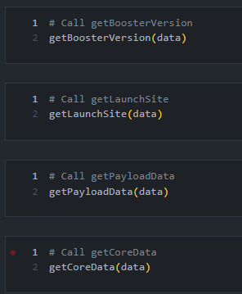
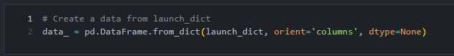
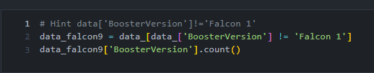
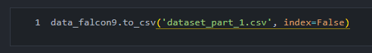
Data Collection – SpaceX API

Slide 9
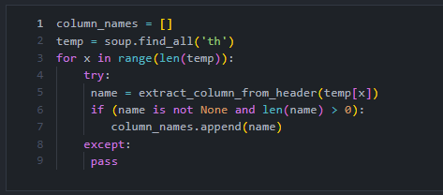
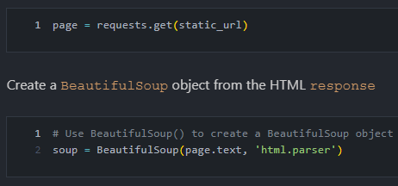
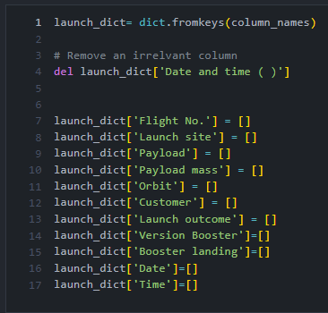

Data Collection - Scraping

Slide 10
Data Wrangling
Describe how data were processed
In the data set, there are several different cases where the booster did not land successfully. Sometimes a landing was attempted but failed due to an accident; for example, True Ocean means the mission outcome was successfully landed to a specific region of the ocean while False Ocean means the mission outcome was unsuccessfully landed to a specific region of the ocean. True RTLS means the mission outcome was successfully landed to a ground pad False RTLS means the mission outcome was unsuccessfully landed to a ground pad. True ASDS means the mission outcome was successfully landed on a drone ship False ASDS means the mission outcome was unsuccessfully landed on a drone ship.
Calculate the number of launches on each site
Calculate the number and occurrence of each orbit
Calculate the number and occurrence of mission outcome per orbit type
Create a landing outcome label from Outcome column

Slide 11
EDA with Data Visualization
Summarize what charts were plotted and why you used those charts:
Visualize the relationship between Flight Number and Launch Site
Visualize the relationship between Payload and Launch Site
Visualize the relationship between success rate of each orbit type
Visualize the relationship between Flight-Number and Orbit type
Visualize the relationship between Payload and Orbit type
Visualize the launch success yearly trend

Slide 12
EDA with SQL
Using SQL for answering to:
Displaying the names of the unique launch sites in the space mission
Displaying 5 records where launch sites begin with the string ‘CCR’
Displaying the total payload mass carried by boosters launched by NASA (CRS)
Displaying average payload mass carried by booster version F9 v1.1
Listing the date where the successful landing outcome in drone ship was achieved.
Listing the names of the boosters which have success in ground pad and have payload mass greater than 4000 but less than 6000
Listing the total number of successful and failure mission outcomes
Listing the names of the booster_versions which have carried the maximum payload mass.
Listing the records which will display the month names, successful landing_outcomesin ground pad ,booster versions, launch_sitefor the months in year 2015
Ranking the count of successful landing_outcomesbetween the date 2010-06-04 and 2017-03-20 in descending order.

Slide 13
Build an Interactive Map with Folium
To visualize the Launch Data into an interactive map. We took the Latitude and Longitude Coordinates at each launch site and added a Circle Marker around each launch site with a label of the name of the launch site.

Slide 14
Build a Dashboard with Plotly Dash
The dashboard is built with Flask and Dash web framework:
Scatter Graph showing the relationship with Outcome and Payload Mass (Kg) for the different Booster Versions
It shows the relationship between two variables.
It is the best method to show you a non-linear pattern.
The range of data flow, i.e. maximum and minimum value, can be determined.
Pie Chart showing the total launches by a certain site/all sites
display relative proportions of multiple classes of data.
size of the circle can be made proportional to the total quantity it represents.

Slide 15
Predictive Analysis (Classification)
BUILDING MODEL
•Loading Data
•Preprocessing
•Split our data into training and test data sets
•Decide which type of machine learning algorithms we want to use
•Set our parameters and algorithms to GridSearchCV
•Fit datasets
EVALUATING MODEL
•Check accuracy for each model
•Plot Confusion Matrix
IMPROVING MODEL
•Feature Engineering
FINDING THE BEST PERFORMING CLASSIFICATION MODEL

Slide 16
Results
Exploratory data analysis results
Interactive analytics demo in screenshots
Predictive analysis results

Slide 17


Slide 18
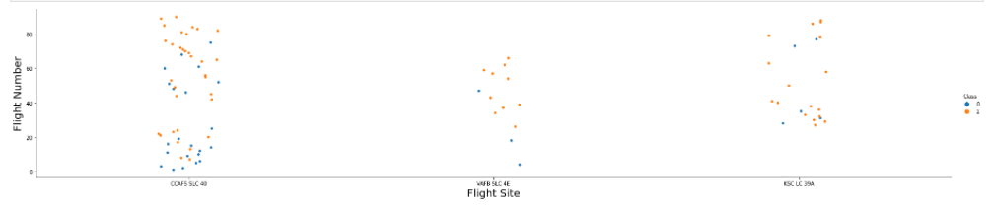
Flight Number vs. Launch Site
Show a scatter plot of Flight Number vs. Launch Site
The more amount of flights at a launch site the greater the success rate at a launch site.

Slide 19
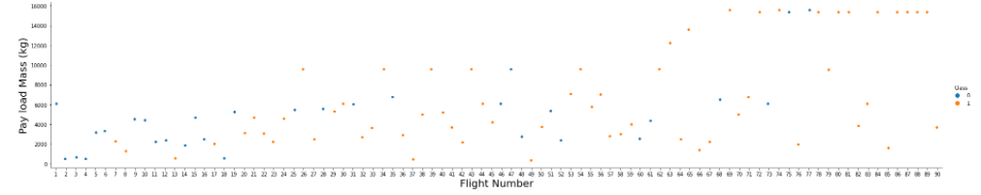
Payload vs. Launch Site
Show a scatter plot of Payload vs. Launch Site:
The greater the payload mass for Launch Site CCAFS SLC 40 the higher the success rate for the Rocket. There is not quite a clear pattern to be found using this visualization to make a decision if the Launch Site is dependent on Pay Load Mass for a success launch.

Slide 20
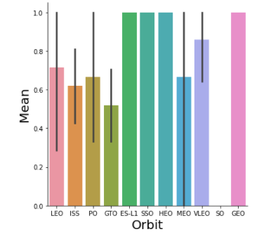
Success Rate vs. Orbit Type
Show a bar chart for the success rate of each orbit type:
Orbit GEO,HEO,SSO,ES-L1 has the best Success Rate.

Slide 21
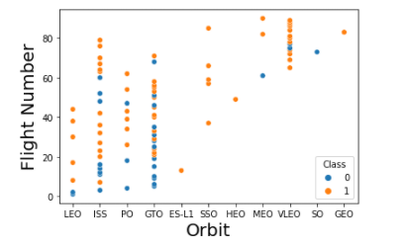
Flight Number vs. Orbit Type
Show a scatter point of Flight number vs. Orbit type:
You should see that in the LEO orbit the Success appears related to the number of flights; on the other hand, there seems to be no relationship between flight number when in GTO orbit.

Slide 22
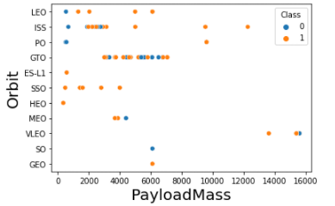
Payload vs. Orbit Type
Show a scatter point of payload vs. orbit type:
You should observe that Heavy payloads have a negative influence on GTO orbits and positive on GTO and Polar LEO (ISS) orbits.

Slide 23
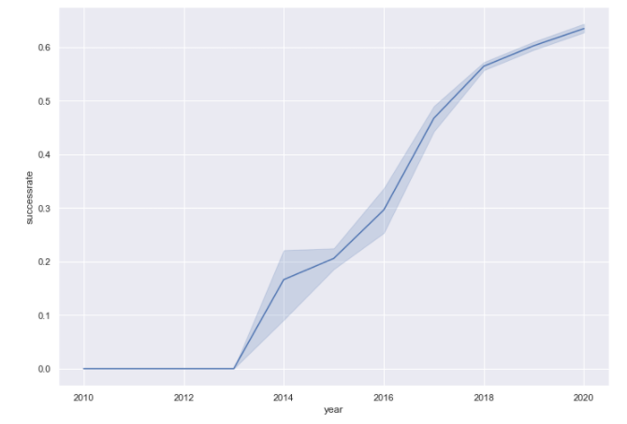
Launch Success Yearly Trend
Show a line chart of yearly average success rate:
you can observe that the success rate since 2013 kept increasing till 2020

Slide 24
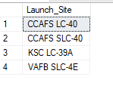
All Launch Site Names
Display the names of the unique launch sites in the space mission
Using the word DISTINCT in the query means that it will only show Unique values in the Launch_Site column from tblSpaceX:
select DISTINCT [Launch_Site] from [dbo].[Spacex]

Slide 25
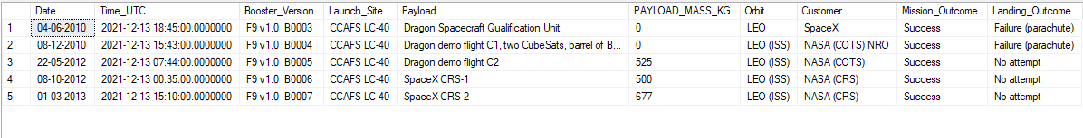
Launch Site Names Begin with 'CCA'
Using the word TOP 5 in the query means that it will only show 5 records from tblSpaceX and LIKE keyword has a wild card with the words ‘CCA%’ the percentage in the end suggests that the Launch_Site name must start with CCA.
SELECT “column_name” FROM “table_name” WHERE “column_name” LIKE {PATTERN};

Slide 26
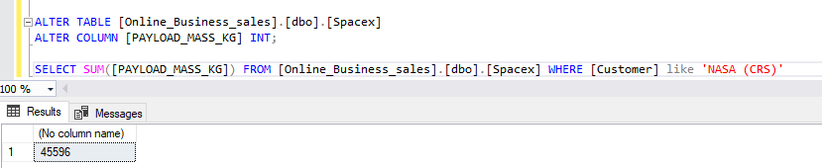
Total Payload Mass
SELECT SUM([PAYLOAD_MASS_KG]) FROM [dbo].[Spacex] WHERE [Customer] like 'NASA (CRS)'

Slide 27
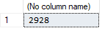
Average Payload Mass by F9 v1.1
seleSELECT AVG([PAYLOAD_MASS_KG]) FROM [dbo].[Spacex] WHERE [Booster_Version] = 'F9v1.1'

Slide 28
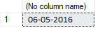
First Successful Ground Landing Date
SELECT MIN([Date]) FROM [dbo].[Spacex] WHERE [Landing_Outcome] like 'Success(droneship)'

Slide 29
Successful Drone Ship Landing with Payload between 4000 and 6000
SELECT [Booster_Version] FROM [Online_Business_sales].[dbo].[Spacex] WHERE ([Landing_Outcome] like'Success(groundpad)') AND ([PAYLOAD_MASS_KG]>4000) AND ([PAYLOAD_MASS_KG]<6000)

Slide 30
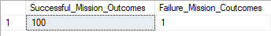
Total Number of Successful and Failure Mission Outcomes
Select (SELECT Count([Mission_Outcome]) from [dbo].[Spacex] where [Mission_Outcome] LIKE '%Success%') as Successful_Mission_Outcomes ,
(SELECT Count(Mission_Outcome) from [dbo].[Spacex] where Mission_Outcome LIKE '%Failure%') as Failure_Mission_Coutcomes

Slide 31
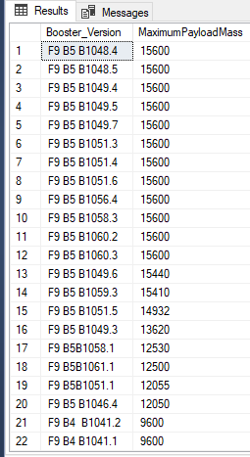
Boosters Carried Maximum Payload
SELECT DISTINCT [Booster_Version], MAX([PAYLOAD_MASS_KG]) AS [MaximumPayloadMass] FROM [dbo].[Spacex] GROUP BY [Booster_Version] ORDER BY [MaximumPayloadMass] DESC

Slide 32
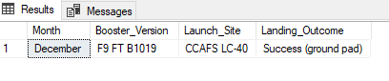
2015 Launch Records
SELECT DATENAME(month, DATEADD(month, MONTH(CONVERT(date, Date, 105)), 0)- 1) AS Month, [Booster_Version], [Launch_Site], [Landing_Outcome]
FROM [dbo].[Spacex]
WHERE ([Landing_Outcome] LIKE N'%Success %') AND (YEAR(CONVERT(date, Date, 105)) = '2015')

Slide 33
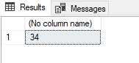
Rank Landing Outcomes Between 2010-06-04 and 2017-03-20
SELECT COUNT(Landing_Outcome) FROM [dbo].[Spacex] WHERE (Landing_Outcome
LIKE '%Success%') AND (Date > '04-06-2010') AND (Date < '20-03-2017')

Slide 34


Slide 35
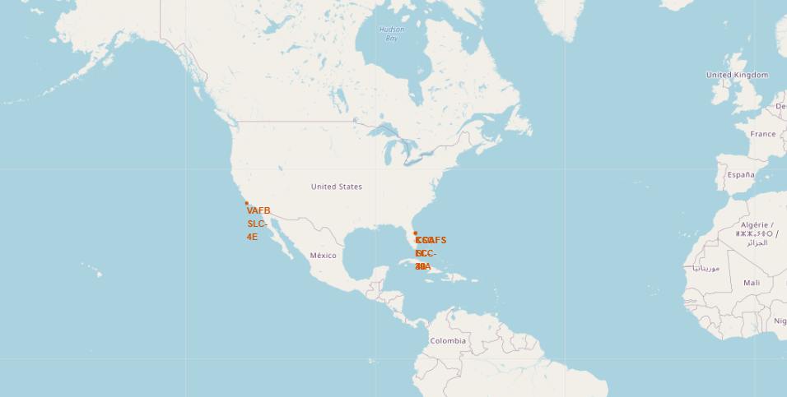
Folium Map: All launch sites global map markers

Slide 36
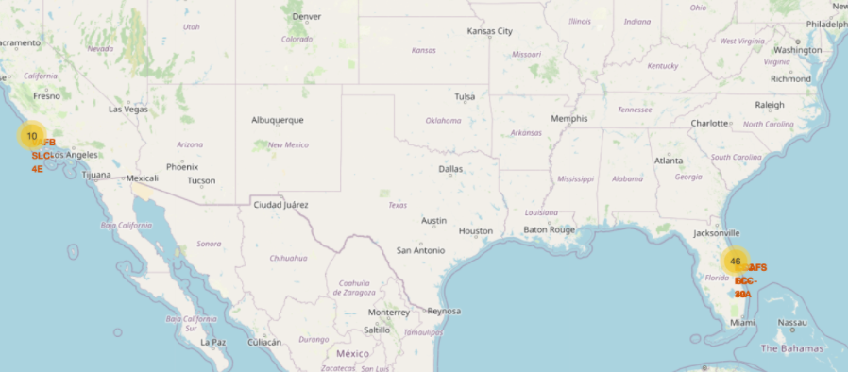
Folium Map

Slide 37
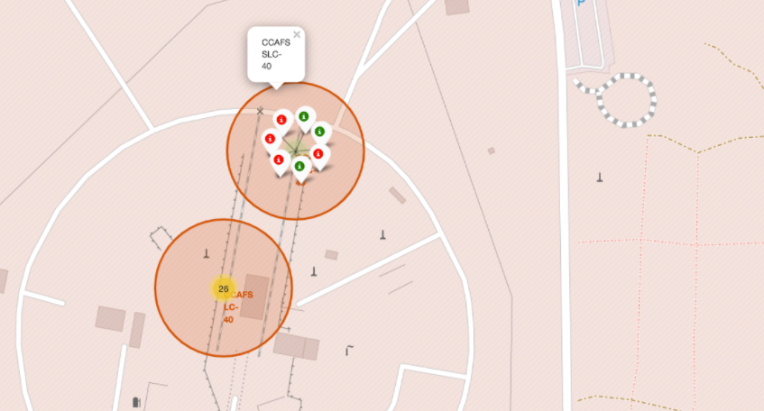
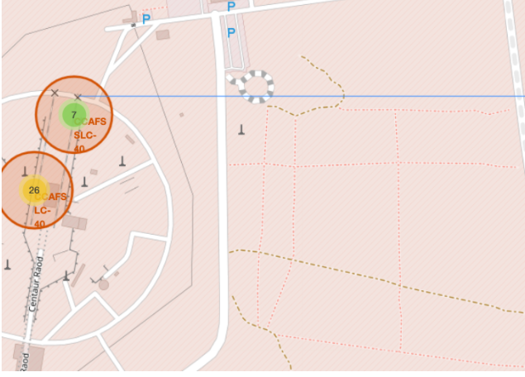
Folium Map: Color Labelled Markers

Slide 38


Slide 39
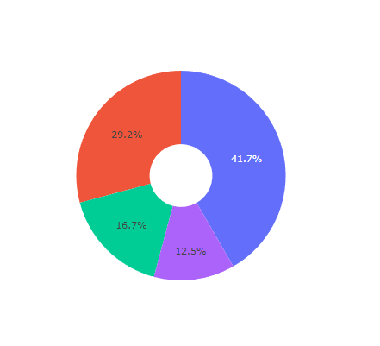
launch success count for all sites
We can see that KSC LC-39A had the most successful launches from all the sites

Slide 40
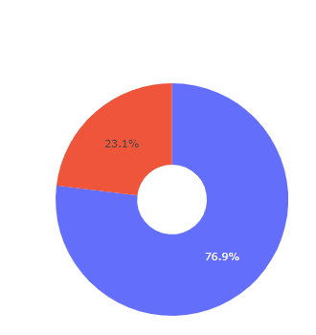
The Pie chart for the launch site with highest launch success ratio
KSC LC-39A achieved a 76.9% success rate while getting a 23.1% failure rate

Slide 41
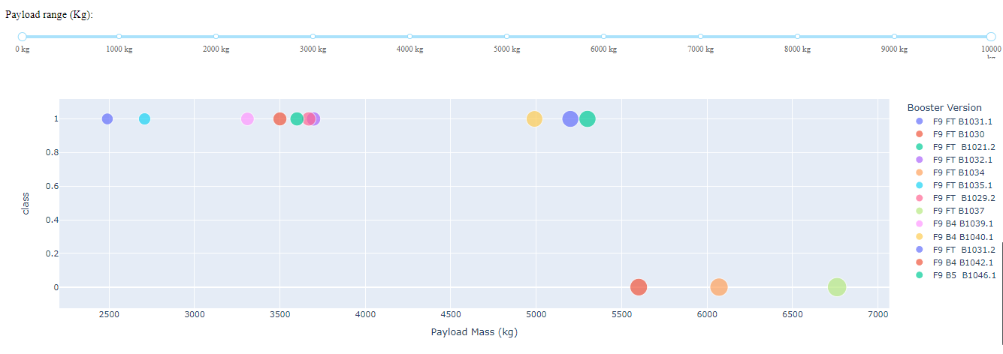
Payload vs. Launch Outcome scatter plot for all sites
We can see the success rates for low weighted payloads is higher than the heavy weighted payloads

Slide 42


Slide 43
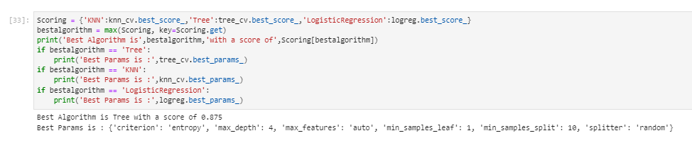
Classification Accuracy
Visualize the built model accuracy for all built classification models, in a bar chart
logistic regression:
SVM:
Tree:
KNN:
Best Model:
After selecting the best hyperparameters for the decision tree classifier using the validation data, we achieved 87.5% accuracy on the test data.

Slide 44
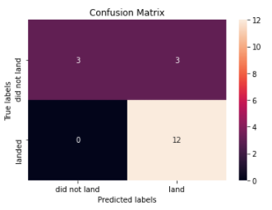
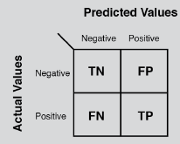
Confusion Matrix
A confusion matrix is a table that is often used to describe the performance of a classification model on a set of test data for which the true values are known.

Slide 45
Conclusions
We can see that KSC LC-39A had the most successful launches from all the sites.
Orbit GEO,HEO,SSO,ES-L1 has the best Success Rate.
The Tree Classifier Algorithm is the best for Machine Learning for this dataset.

Slide 46


Appendix
For doing this project we use Jupyter Lab for our coding in Python language and Microsoft SQL Server Management Studio 18 for Query Language.

Slide 47


